Slide 1
Domestic Violence 101

Slide 2
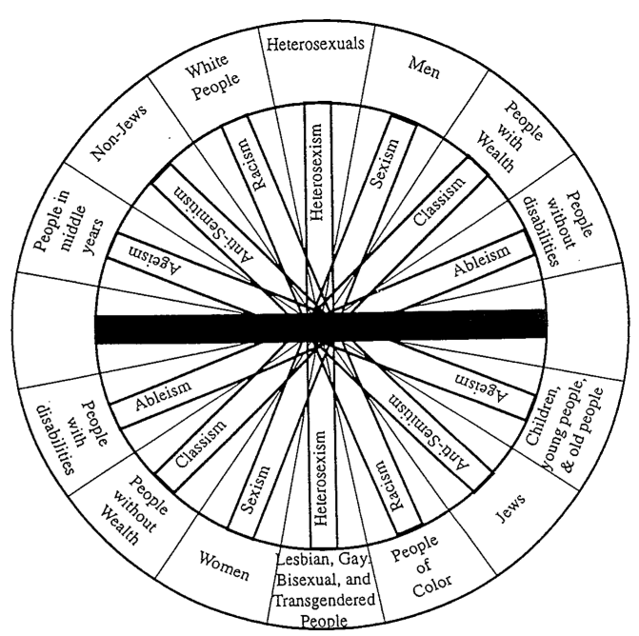
Wheel of Oppression

Slide 3
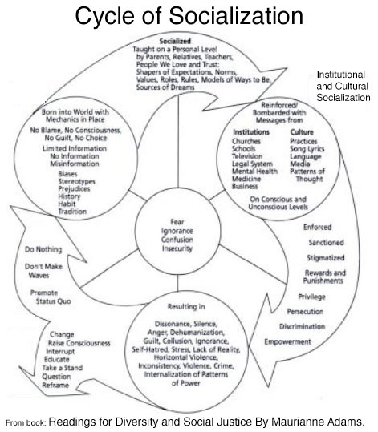

Slide 5
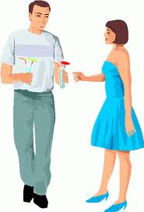
What does Sam do to gain power
in the relationship and control
over Kelly’s choices?

Slide 6
Why doesn’t she leave?
Isolation and entrapment

Slide 7
Safety: Balancing Risks
Partner generated
Life generated
Partner generated
Life
generated

Slide 8
Advocacy
Listen
Non-judgmental; validate
Connect
Earn trust & show you are an ally
Refer
Understand the situation & factors most important to her/his life context

Slide 9
Advocacy: The Antidote to Power and Control

Slide 10
Questions?

